Slide 1


Launch your success with the Success Center
How to log in to estorm, register for swic alert, log in to blackboard, sign up for scoty, check your email and use office365

Slide 2
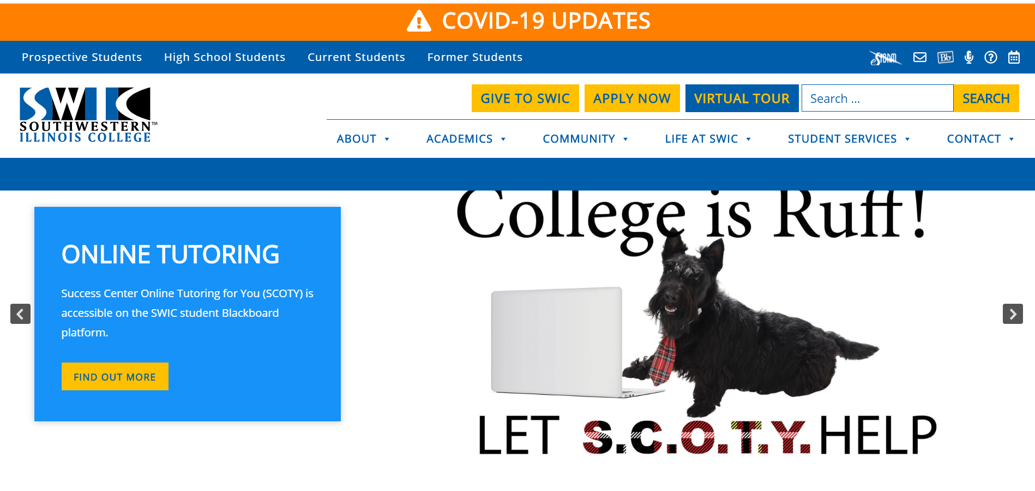
Accessing your student technology begins with estorm

Slide 3
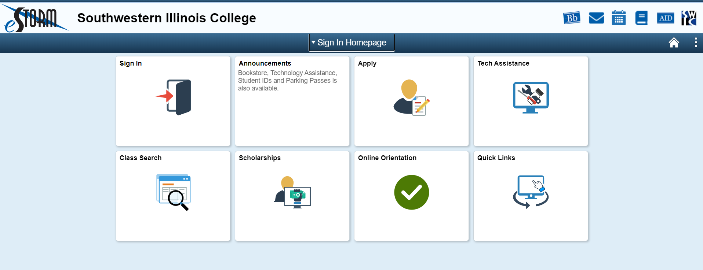
Click the sign in tile

Slide 4
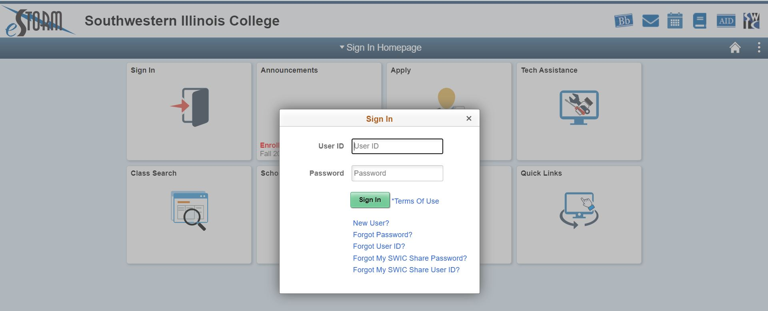
Enter your student id and password

Slide 5
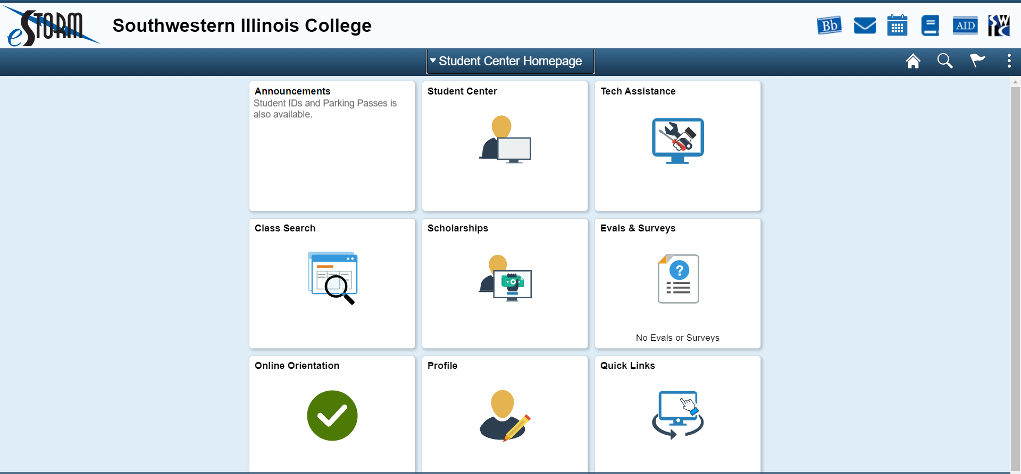
This is your student center homepage

Slide 6
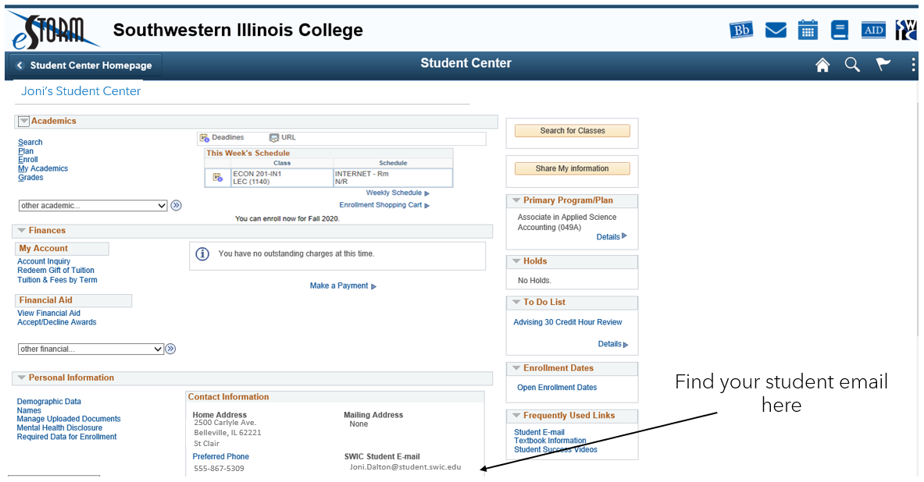
Student Center homepage

Slide 7
From your Student Center Homepage you can:
See your student details
Search for classes
Check on your scholarship applications
Complete Evals & Surveys if available
Complete your Online Orientation
Check your Quick Links

Slide 8
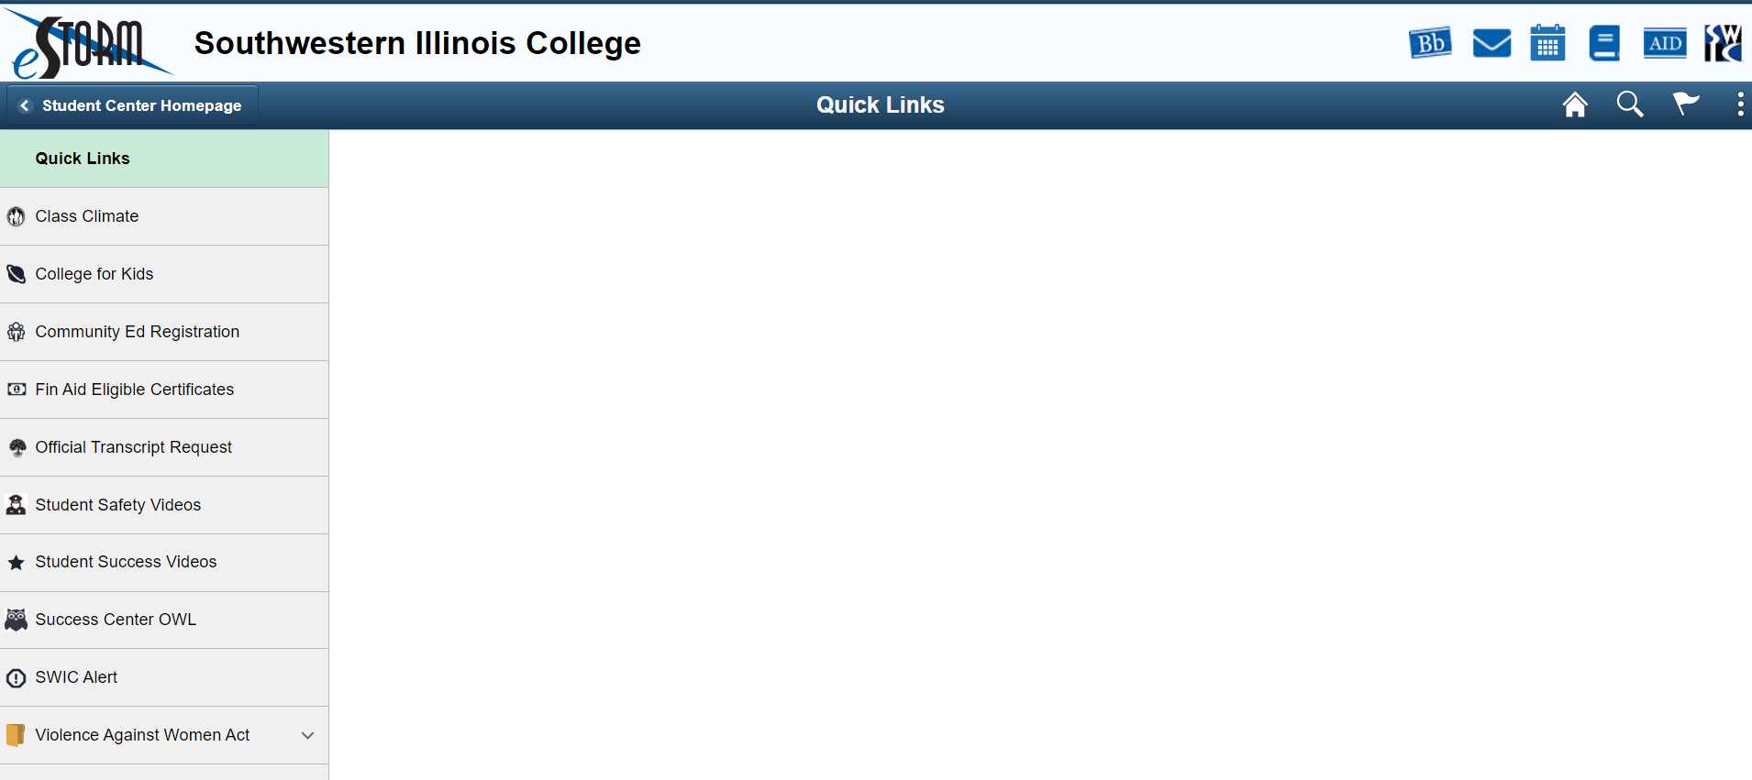
Quick links
Where to check your Financial Aid
See your transcripts
Student safety videos
Student Success videos
Where to submit papers to have them reviewed by the Success Center
Register for SWIC Alert here

Slide 9
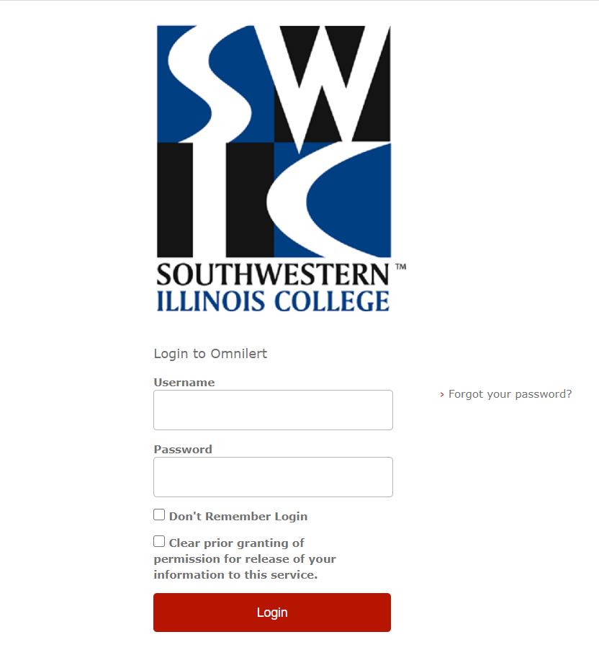
SWIC alert
Use your eStorm login to register for SWIC Alert
This alerts you when the campus is closed due to weather, building issues, etc.
Alerts you when there is a situation on campus that you need to be aware of
Your registration for SWIC Alert is good for two years
If you change your contact information, please update your SWIC Alert

Slide 10
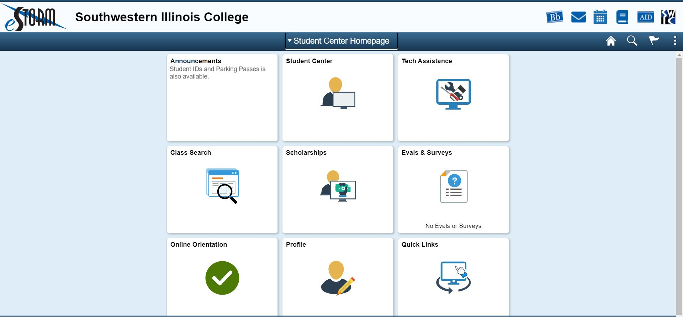
How to log in to Blackboard
From Student Center Homepage, click the Bb in upper right

Slide 11
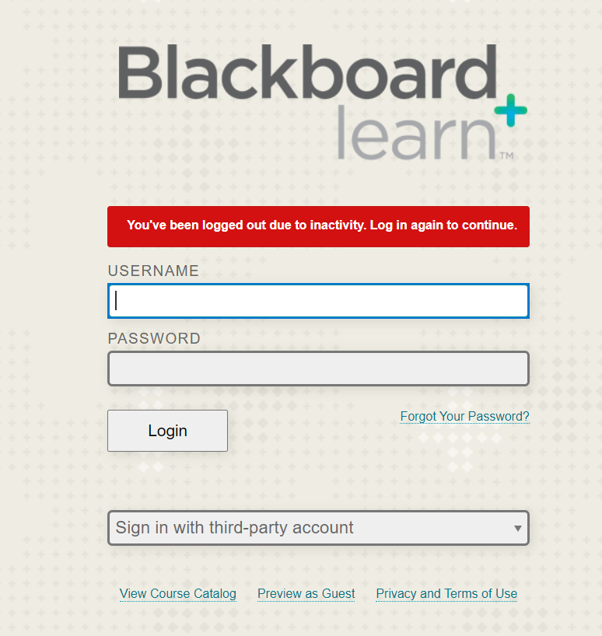
How to use blackboard
Use your eStorm username and password to log in to Blackboard
All of your classes will be in Blackboard
You can find your course syllabi here as well as your instructor contact information
SCOTY is the online tutoring available to all registered SWIC students
Success Center Online Tutoring for You: (SCOTY) – Enroll in SCOTY through Blackboard Announcements

Slide 12
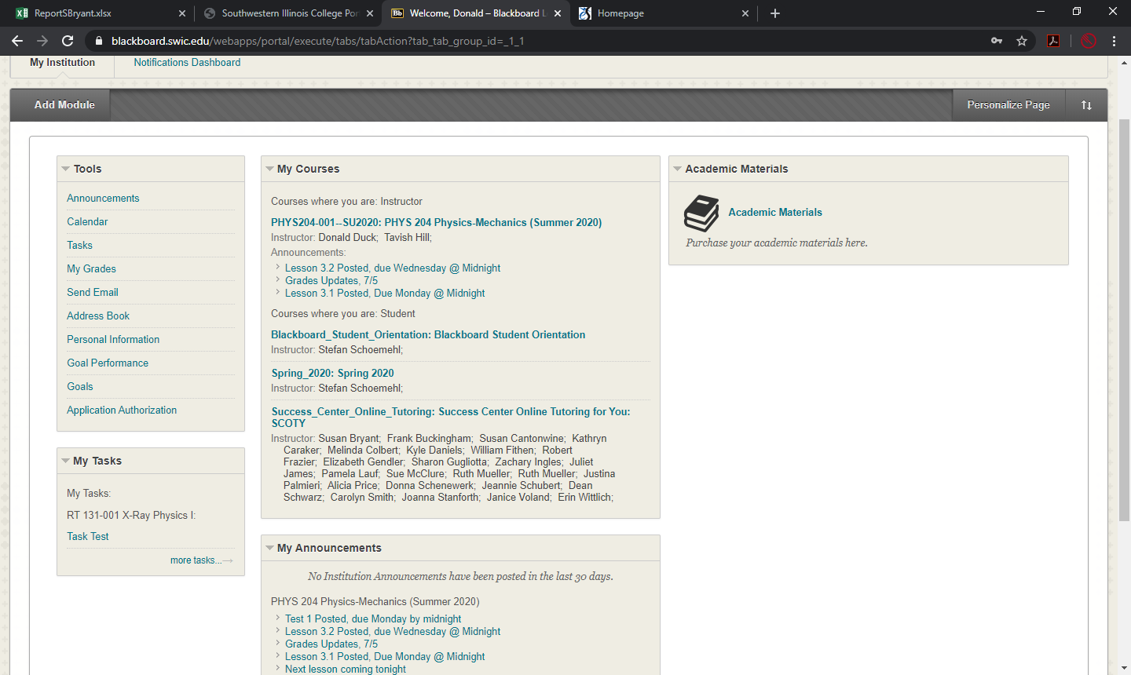
Click here to access SCOTY and get started.

Slide 13
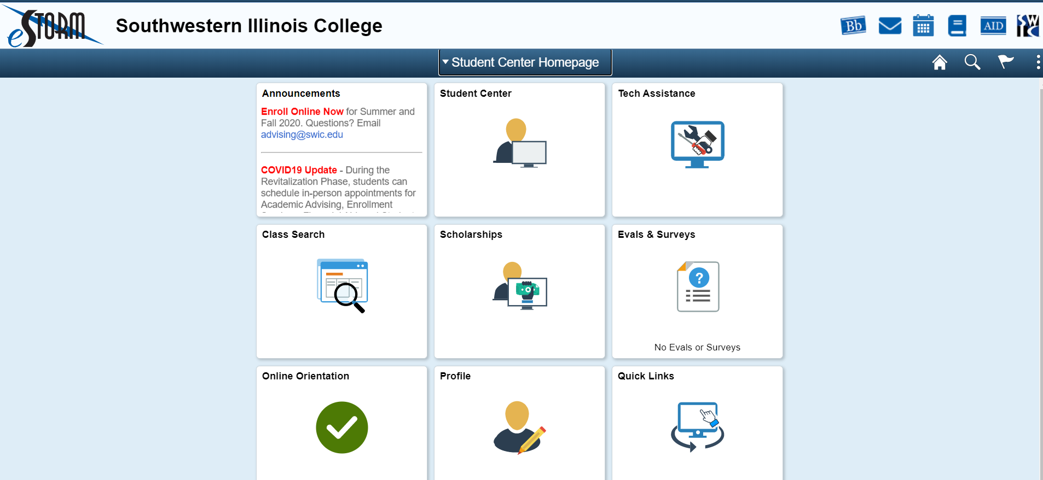
Student email and office365
Click here to access your student email and Office365

Slide 14
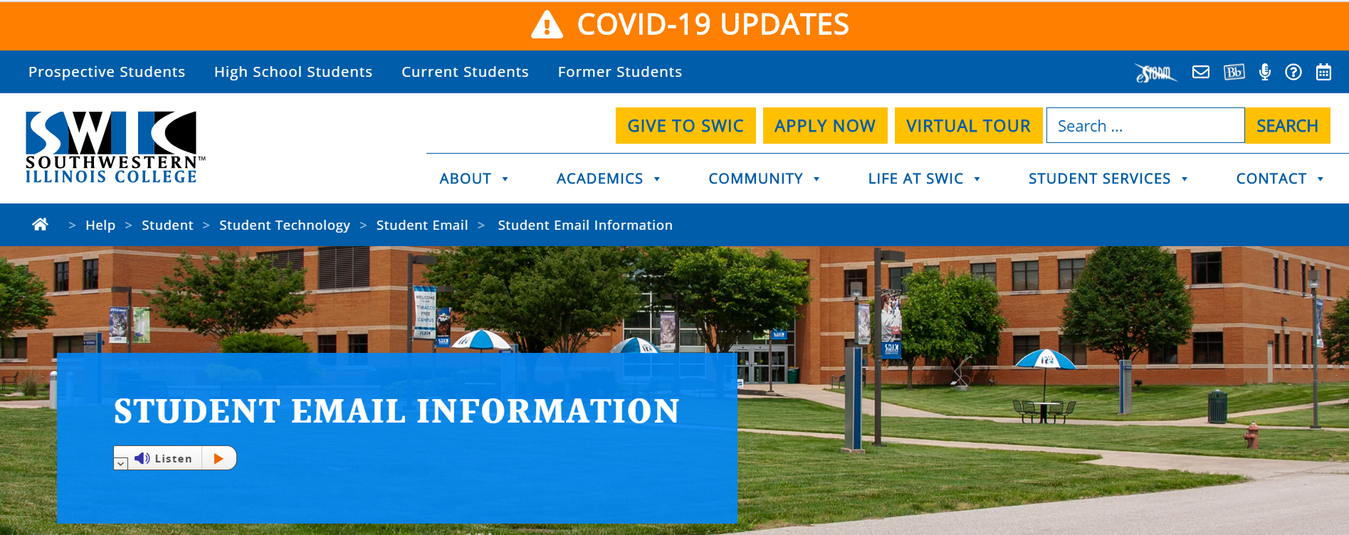
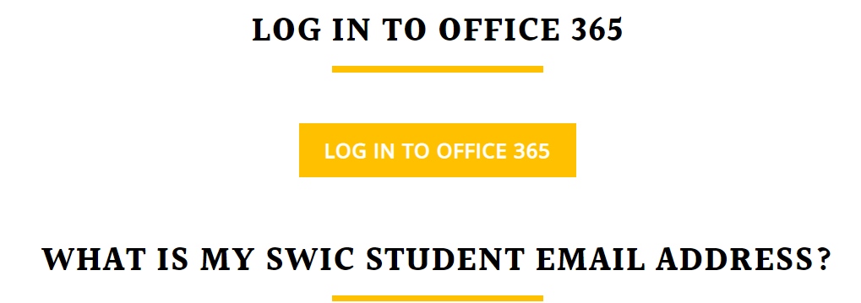
Scroll down until you see the LOG IN TO OFFICE365 and click on it

Slide 15
Logging in to email
Your email address is listed in your eSTORM Student Center, in the Personal Information section.
SWIC is partnering with Microsoft to provide your student email account.
If you are already logged in to a Microsoft email account, you must log out of that account before you can access your SWIC student email account.
Use your eStorm password with your student email address to log in to your email.
Use your student email to communicate with your instructors and include your class name in subject line.
This gives you access to Office365, including downloading it to your personal computer, for as long as you are an active student at SWIC.
You can save your papers / files on your One Drive to use on any computer. One Drive auto saves every seven seconds, so you won’t lose your paper in a power outage or computer crash.

Slide 16
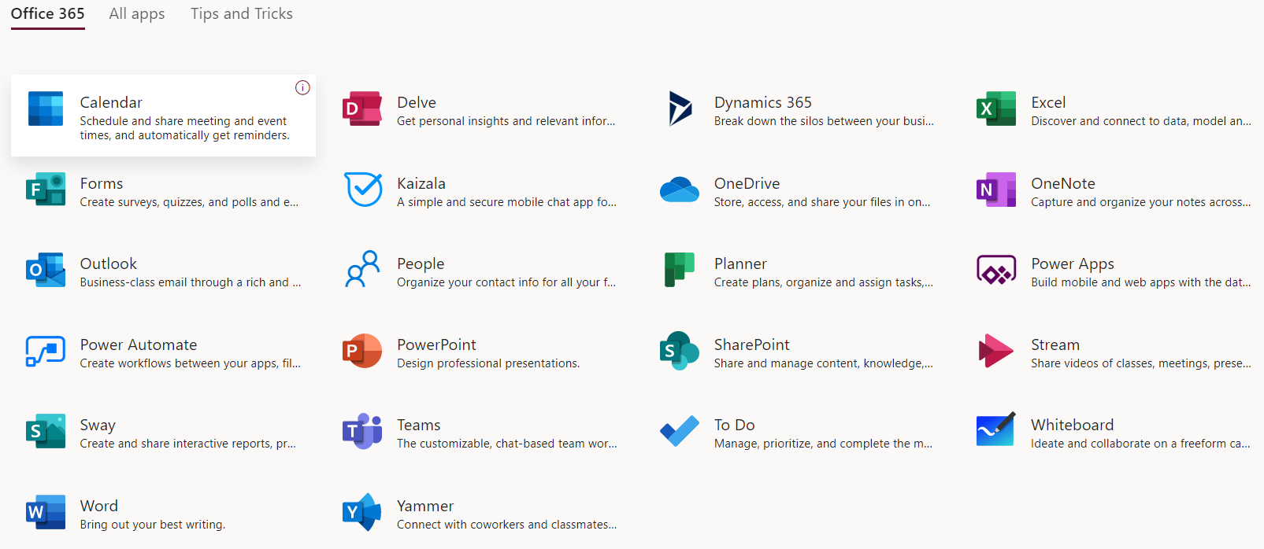
Office365 apps
Save your papers and files here
SWIC is now using Teams to access other SWIC students and instructors in an audio-video format

Slide 17
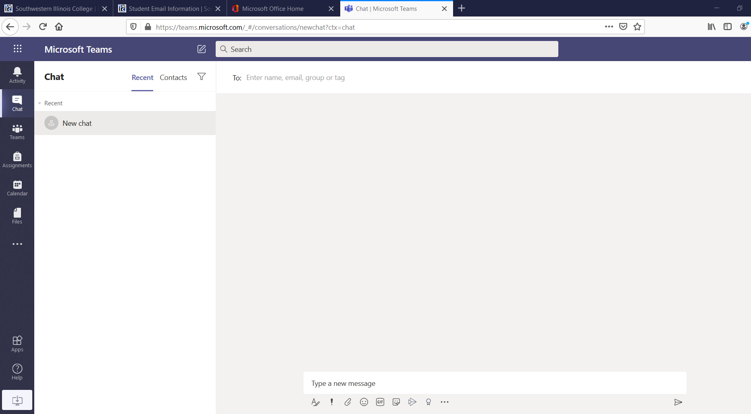
Teams home page
Enter instructor’s information and other student’s information to connect with them through Teams.
Begin your chat here

Slide 18
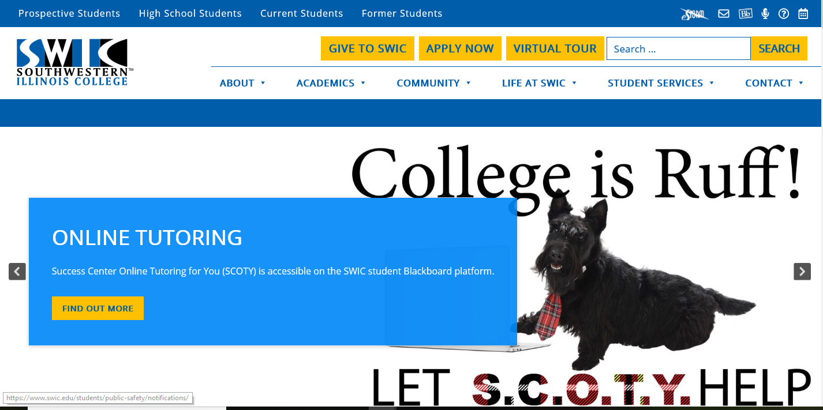
You can also access your SWIC technology here

Slide 19
Questions?
If you have any questions about this presentation or need help with your classes, please contact the Success Center at:
SuccessCenters@swic.edu
or
618-222-5495
The Success Center team at Belleville, Sam Wolf Granite City and Red Bud Campus Success Centers look forward to working with you!

